Slide 1
Food Waste as a Commodity
“You can tell how high a society is
by how much of its garbage is recycled.”
—Dhyani Ywahoo, Native American
Public-Private Alliance

Slide 2
From Waste to Profit
Commercial Food Waste collected
Farm Waste: Manure
Transported to Anaerobic Digester Site
Processed
Placed in Anaerobic Digester
Organic Liquid Fertilizer
Gas: Methane
Sold to Farmers
Combusted in generators to produce electricity

Slide 3
Project Objective
Divert the 9,544 tons of food waste in Alachua County away from landfills and get it into the energy grid
Reduce greenhouse gas emissions from landfills and turn trash into a substantial source of clean energy.
Produce a liquid organic fertilizer that can be sold in both national and local markets.

Slide 4
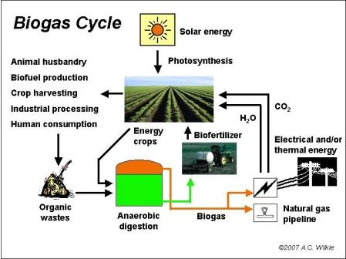
Anaerobic Digestion

Slide 5
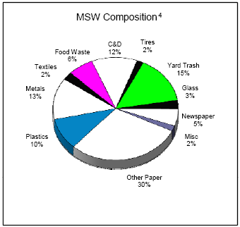
Alachua County
159,080 tons per year of municipal solid waste (MSW)
158,280 tons is shipped to Union County
6% of MSW is Food Waste (9,544 tons)

Slide 6
Collection and Transportation of Food Waste
Food Waste Inventory
Types and Amount
Seasonal Variability
Collection of food waste
Food waste producers interest
Separation of food waste
Equipment
Transportation of food waste
Vehicle
Cost
Notes:
Food Waste Inventory – The types and amount of food waste available and what is the seasonal variability in individual and total food waste supplies?
Collection of food waste - the commercial food waste producers’ interest in the project and what is the collection cost of commercial food waste?
Separation of food waste – the type of equipment is available and needed to maximize the separation of food waste? the cost for it at food waste source site?
Transportation of food waste - the vehicle options for transportation of food waste? the costs to transport food waste to AD site?

Slide 7
Anaerobic Digester Facility Options
Types of AD that can be used
Batch, Continuous, Two Chamber
Pretreatment
Max AD performance
Odor issues
Processing
Construction and Operation Cost Estimates
Facility design, water requirements
Post-treatment
Requirements to turn slurry into fertilizer
Notes:
Pretreatment- the pretreatment options and costs to maximize AD performance? the odor issues for these options?
Processing- the AD facility design options, water requirements and cost estimates for construction and operation? Wastewater use? additional feedstocks to enhance AD performance?
Post-treatment –options for post-treatment of the AD slurry to use as liquid organic fertilizer?

Slide 8
Anaerobic Digester Facility Energy Outputs
Methane
Production and Uses
Electricity
Conversion Efficiencies
Uses and Revenues
GRU
Wastewater
Potential Use
Nutrients/Sludge
Quality and Quantity of Nutrient Recovery
Notes:
Methane - potential for biogas production and its potential uses
Electricity - the conversion efficeincies from methane to electricity. the various uses and revenues.
Wastewater - the quantity and the potential uses. cost for said uses.
Nutrients/Sludge - estimated digestate quality and quantity for nutrient recovery to be used as fertilizer, compost agent and/or soil amendment. the technical aspects of nutrient concentration, separation, handling and storage. opportunity for sale into the agriculture and horticulture market as organic fertilizer. the local opportunities for it’s use. the issues and plans with delivery.

Slide 9
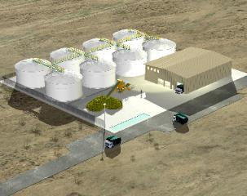
Siting of Anaerobic Digester
Strengths, weaknesses, opportunities and threats given at various development sites
Estimated Development Costs
Zoning Requirements
Permits
Notes:
the zoning requirements for an AD facility. permits and environmental studies are needed. the possible activities on each site with regard to an AD project. the estimated development costs needed on the properties to site a facility.

Slide 10
Revenue and Expense Review
Cost to build a food waste to energy plant and operate annually
Annual revenues and Expenses
Potential Funding Sources

Slide 11
Local Community Benefits
Providing clean energy into the grid
Minimizing the transportation costs of shipping Alachua County’s waste to Union County
Minimizing Landfill use
No odor
Accommodating local famers with organic fertilizer

Slide 12
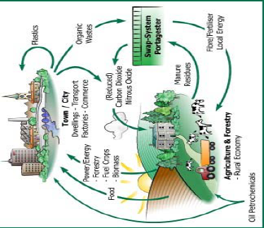
Opportunity for Growth

Slide 13
Current Facilities
East Bay Municipal Utility District
Using Anaerobic Digestion to process food waste and waste water in Oakland, California
Biogas Energy Project at the University of California, Davis
anaerobic phased solid digester has been converting restaurant food waste into an energy soup since October 24, 2006

Slide 14
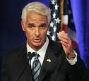
POLICY
Florida’s Governor Charlie Crist
Goal : 75% of waste diverted from landfills by 2020
U.S President Barack Obama promised to spend $150 billion over the next 10 years developing alternative energy

