Slide 1


Florida (FL) Renewable Energy (RE) Governmental Policy: State Level Holistic Overview
Cropped Part of Organization Logo. Florida Alliance For Renewable Energy. Florida. Copyright 2008-2009. All rights reserved.
<http://www.floridaallianceforrenewableenergy.org/>.
Homepage Picture. “The Florida Senate.” flsenate.gov. Copyright © 2000-2009 State of Florida. <http://www.flsenate.gov/Welcome/index.cfm?CFID=153899993&CFTOKEN=36097851>.
By Divik Schueller
Intern, Dr. Ann C. Wilkie’s Summer 2009 Bioenergy Summer School

Slide 2
To Understand
FL RE Policymaking Terminology/ Concepts
Main Objective
Objective Achieved Through Understanding
Corresponding Societal Implications
How government impacts citizenry
How State Government RE Policymaking Influences RE Usage In Florida
Why State Government RE Policymaking Is Important

Slide 3
Abundant RE Resources
Research and
Development (R&D)
Many Small RE
Businesses
More Jobs
Fewer Emissions
Reduces Foreign Oil
More
Reasons…
Most Florida Energy Consumption From Fossil Fuels Despite RE Advantages
Why Discuss State Level RE Politics?
Becoming More Cost Competitive

Slide 4
What This Means
RE Resources Underutilized Despite Technological Advances
Government Help Needed: Some Important Initiatives
Subsidies
Regulations Promoting RE R&D
Carbon Taxes
Pollution Restrictions
Etc…
¹Feed-In-Tariffs
¹Stiftung, Heinrich Boil (The Green Political Foundation). “Feed-in Tariffs in America: Driving the Economy with Renewable Energy Policy that Works”. John Farrell New Rules Project. April 2009. pg. 6.

Slide 5
Importance of Government – What About Free Markets?
Government Involved In Nearly All RE Aspects
Despite Privatization of Most Businesses
State laws regulate power recipients and energy sources
Goods and services taxed
Laws regulate RE
Building/ infrastructure placement needs governmental approval

Slide 6
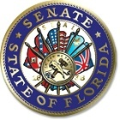
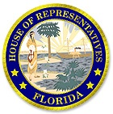
Which Leads To…
U.S. Government
(Federal)
Legislative
Judicial
Executive
Senate
House of Representatives
1 Legislator Each District (Governing and Making Policies)
Implement Specific RE Laws/ Regulations
FL Governor
Florida Government (State)
“Welcome Page.” Online Sunshine: Official Website of the Florida Legislature. Copyright © 1995-2009. The Florida Legislature. Tallahassee, FL. <http://www.leg.state.fl.us/Welcome/index.cfm?CFID=95501045&CFTOKEN=90778558>.
Notes:
Citizens Must Follow (Legally)

Slide 7
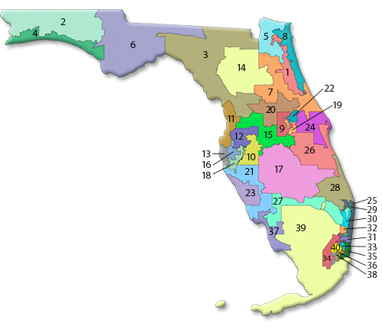
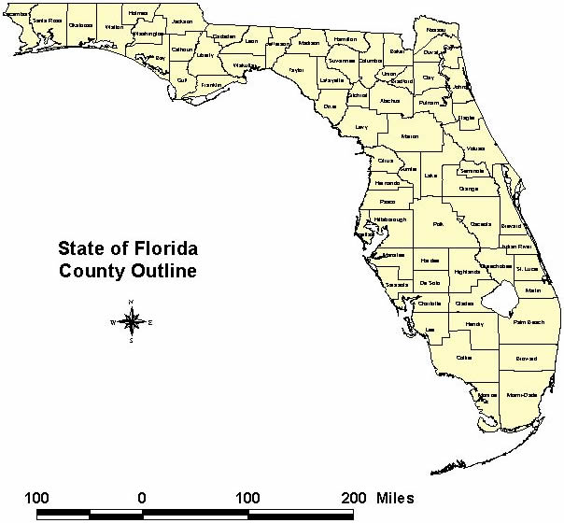
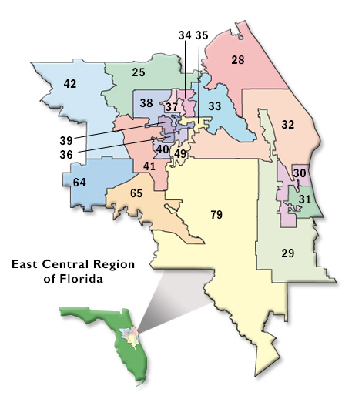
Can You See The Difference?
One legislative district can contain parts of many counties
County Map
Example Representative District Map:
East Central Region
Senator District Map
“East Central Region of Florida.” University of Central Florida Libraries: Government Information and Related Resources. Orlando, FL. Copyright © 2008. Last Updated May 5, 2009.
<http://library.ucf.edu/govdocs/Images/eastcentral_districts.jpg>.
“Senate District Map.” The Florida Senate. flsenate.gov. Copyright © 2000-2009. State of Florida. Tallahassee, FL.
<http://www.flsenate.gov/Legislators/index.cfm?Mode=District%20Information&Submenu=2&Tab=legislators>.
Florida Division of Emergency Management (FDEM). “State of Florida: County Outline.” floridadisaster.org. Copyright © 2002 FDEM. Tallahassee, FL. <http://www.floridadisaster.org/images/county_outline.jpg>.

Slide 8
FL Governor Information Overview
Election held every 4 years
People elect governor (majority vote)
Current Governor can suspend election
If declare state emergency
Governor: 1 full term = 4 years, 2 terms max.
Power to employ other people in government
To protect citizens and the state
Can veto Legislative bills
Veto overturned 2/3 Legislative majority
Head of FL state government
“The 2009 Florida Statutes.” Online Sunshine. Copyright © 1995-2009 The Florida Legislature. Tallahassee, FL. <http://www.leg.state.fl.us/Statutes/index.cfm?Mode=View%20Statutes&Submenu=1&Tab=statutes>.
Notes:
(101.733 f.s.)
Office in state capitol building: Tallahassee
(14.01 f.s.)

Slide 9
Governors Energy Act
Submitted by US Senate
Created Solar Rebate Program
Sales Tax Holiday (for energy efficiency products)
Streamlined Power Plant Permitting
Promoted RE Utilization
Approved By FL Legislature
Florida Energy and Climate Commission. “2006 Florida Energy Act”. MyFlorida. 2009 Department of Management Services. <http://myfloridaclimate.com/climate_quick_links/florida_energy_climate_commission/energy_climate_change_policy/2006_florida_energy_act>.
Notes:
Called 2006 Florida Energy Act
Established Florida Renewable Energy Technologies and Energy Efficiency Act
as Bill 888
Discussed future FL state energy plans
Amended FL Power Plant Sitting Act

Slide 10
Florida Renewable Energy Portfolio Standard
¹Minimum percentage electricity sales a provider is legally obliged to supply from RE produced in FL¹
Developed by PSC
¹PSC required by law to consult
¹Must be ratified by Legislature
²Currently a RPS is NOT in FL
²Proposed Measure: 20% utility electricity from RE sources by 2020
Department of Environmental Protection
Florida Energy and Climate Commission (FECC)
¹”The 2009 Florida Statutes: Title XXVII: 366.92: Florida renewable energy policy.” The Florida Senate. flsenate.gov. Copyright © 2000-2009. State of Florida. Tallahassee, FL. <http://www.flsenate.gov/Statutes/index.cfm?App_mode=Display_Statute&Search_String=&URL=Ch0366/SEC92.HTM&Title=-%3E2008-%3ECh0366-%3ESection%2092#0366.92.>
²State of Florida. “Florida Governor Charlie Christ.” MyFlorida.com. Copyright 2008. Tallahassee, FL. <http://www.ask.com/bar?q=Do+we+have+renewable+energy+portfolio+standard+in+Florida&page=1&qsrc=0&ab=0&u=http%3A%2F%2Fwww.flgov.com%2Frelease%2F10565>.
Notes:
^{Aimed at utilities}
(FL Statute 366.92)

Slide 11
Public Service Commission (PSC)
Goal
Goals Fulfilled Through²
Economic Regulation
Facilitate Efficient Provision Of Safe and Reliable Utility Services At Fair Prices².
Regulatory Oversight
Service Regulation and Consumer Assistance
Responsible for utility and consumer power regulation
¹Jane Maxwell. Florida Alliance For Renewable Energy (FARE). Officer. Answered In Divik Schueller’s Questionairre. June 10, 2009.
²“Mission Statement and Goals”. Florida Public Service Commission. 2009. Tallahassee, Florida. <http://www.psc.state.fl.us/about/mission.aspx>.
Notes:
Recent Policy Initiative¹
Legislator and governor charged PSC with providing plan for a RPS
Submitted to Legislator (February 2008)
Policy Ignored

Slide 12
PSC Organizational Structure
Governor Appoints 5 PSC Members
4 Year Terms Each Commissioner
Commissioner Chairman
Elected Majority Vote By PSC Members
2 Year Term
Commissioner Chief Administrative Officer
Policy Initiated Only Through Majority Vote of Commission Members
Except When 2 Commission Members In Proceeding
Chairman Final Vote After Reviewing
Confirmed By Florida Senate
“STATEMENT OF AGENCY ORGANIZATION & OPERATIONS.” Florida Public Service Commission. October 2008. Tallahassee, FL. Page 2. <http://www.psc.state.fl.us/home/files/SAOO.pdf>.

Slide 13
Net Metering
²System allowing anyone get credit for energy they generate up to 2 MW
²Get this credit by reduction in their utility bill according to amount of power generated
¹Sell back energy to utility at retail rates
²Save up to 2 MW per hour utility bill deduction
²Each utility different rates different customers
When customer not selling energy to grid, can receive energy from grid via proving utility³
⁴Approved by FL PSC: March 2008
⁴Applies only to investor- owned utilities
“Not apply to electric cooperatives or municipal owned utilities”⁴
¹ Navigant Consulting. “Florida Renewable Energy Potential Assessment: Full Report: Draft”. 24 Nov. 2008. Burlington, MA. Page 216.
²Maxwell, Jane. Florida Alliance For Renewable Energy (FARE). Officer. Answered In Divik Schueller’s Questionnaire. June 10, 2009.
³DSIRE: Database of State Incentives for Renewables & Efficiency. “Glossary: Rules, Regulations & Policies: Net Metering”. © 2009 N.C. Solar Center / N.C. State University / College of Engineering . <http://www.dsireusa.org/glossary/>.
⁴DSIRE: Database of State Incentives for Renewables & Efficiency. “Florida: Incentives/ Policies for Renewables & Efficiency”. © 2009 N.C. Solar Center / N.C. State University / College of Engineering .
<http://www.dsireusa.org/incentives/incentive.cfm?Incentive_Code=FL19R&re=1&ee=1>.
Notes:
⁴For solar, geothermal, wind, biomass, ocean, hydrogen, waste heat or hydroelectric

Slide 14
Net Metering
www.dsireusa.org / July 2009
42 states & DC
have adopted a
net metering policy
State policy
*
Voluntary utility program(s) only
State policy applies to certain utility types only (e.g., investor-owned utilities)
Note: Numbers indicate system capacity limit in kW. Some state limits vary by customer type, technology and/or system application. Other limits might also apply.
DSIRE: Database of State Incentives for Renewables & Efficiency. “Glossary: Rules, Regulations & Policies: Net Metering. © 2009 N.C. Solar Center / N.C. State University / College of Engineering . <http://www.dsireusa.org/glossary/>.
Notes:
DSIRE is a comprehensive source of information on state, local, utility, and federal incentives and policies that promote renewable energy and energy efficiency. Established in 1995, DSIRE is an ongoing project of the NC Solar Center and the Interstate Renewable Energy Council funded by the U.S. Department of Energy.

Slide 15
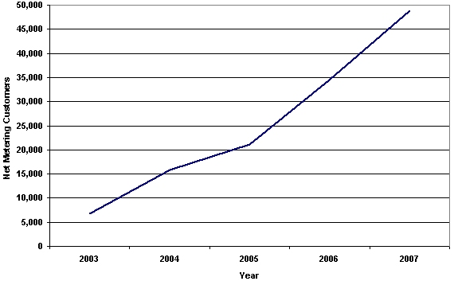
U.S. Net Metering Customers, 2003-2007
United States Government: Department of Energy. “Green Pricing and Net Metering Programs: 2007 Edition.” Energy Information Administration (EIA). Data For 2007. April 2009. <http://www.eia.doe.gov/cneaf/solar.renewables/page/greenprice/green_pricing.html>.

Slide 16
Feed-In-Tariff (FIT) a.k.a. Renewable Energy Dividend (RED)
Homeowner sells power to electricity grid for premium price, but buys their power from the grid at retail rates¹
³In Florida, only done through Gainesville Regional Utilities (GRU)
For Solar PV only
Enacted 2009
Customers must have PV system installed : generate electricity and sell to GRU (electric grid)
20 year contract, fixed price
¹Stiftung, Heinrich Boil (The Green Political Foundation). “Feed-in Tariffs in America: Driving the Economy with Renewable Energy Policy that Works”. John Farrell New Rules Project. April 2009. pg. 6.
²Flyer Distributed by Jane Maxwell. “What is a Renewable Energy Dividend Policy?”. Florida Aliance For Renewable Energy. 2009.
³GRU: (Gainesville Regional Utilities). “Solar FIT”. Gainesville, FL. 2009 <http://www.gru.com/OurCommunity/Environment/GreenEnergy/solar.jsp>.
Notes:
FIT often called RED because the word “tariff” seen as discouraging to our current system of Capitalism
Tariff seen as government is taking money away from consumers
²Positive Benefits
Quickest way Increase Consumer RE Usage
Increases Energy Production
Slows Energy Cost Increases By Replacing Fossil Fuels
²Future FARE Focus Primarily On Solar Photovoltaic (PV)

Slide 17
Total Electricity Generation | 15,964
United States Government: Department of Energy. “Florida: Reserves & Supply: Net Electricity Generation.” Energy Information Administration (EIA). Published July 23rd, 2009. <http://tonto.eia.doe.gov/state/state_energy_profiles.cfm?sid=FL>.

Slide 18
¹Total (1,629.6)
¹ United States Government: Department of Energy. “Table S7. Transportation Sector Energy Consumption Estimates, 2006.” Energy Information Administration (EIA).
<http://www.eia.doe.gov/emeu/states/sep_sum/html/sum_btu_tra.html>.
²Self Calculation: With TI-30X IIS Calculator

Slide 19
State Government RE Policymaking
Legislature
Public Service Commission
Net Metering
Feed-in-tariff (FIT)
Net electricity generation
Transportation sector energy consumption
Florida Governor
Governors Energy Act
Renewable Energy Portfolio Standard (RPS)

Slide 20
Sources
Cropped Part of Organization Logo. Florida Alliance For Renewable Energy. Florida. Copyright 2008-2009. All rights reserved. <http://www.floridaallianceforrenewableenergy.org/>.
DSIRE: Database of State Incentives for Renewables & Efficiency. “Florida: Incentives/ Policies for Renewables & Efficiency”. © 2009 N.C. Solar Center / N.C. State University / College of Engineering .
DSIRE: Database of State Incentives for Renewables & Efficiency. “Glossary: Rules, Regulations & Policies: Net Metering”. © 2009 N.C. Solar Center / N.C. State University / College of Engineering . <http://www.dsireusa.org/glossary/>.
“East Central Region of Florida.” University of Central Florida Libraries: Government Information and Related Resources. Orlando, FL. Copyright ©2008. Last Updated May 5, 2009.
<http://library.ucf.edu/govdocs/Images/eastcentral_districts.jpg>.
Florida Division of Emergency Management (FDEM). “State of Florida County Outline.” floridadisaster.org. Copyright © 2002 FDEM. Tallahassee, FL. <http://www.floridadisaster.org/images/county_outline.jpg>.
Florida Energy and Climate Commission. “2006 Florida Energy Act”. MyFlorida. 2009 Department of Management Services. <http://myfloridaclimate.com/climate_quick_links/florida_energy_climate_commission/energy_climate_change_policy/2006_florida_energy_act>.
Flyer Distributed by Jane Maxwell. “What is a Renewable Energy Dividend Policy?”. Florida Alliance For Renewable Energy. 2009.
Google Engine Image Search. ©2008. <http://202.118.40.5/y2/img/200851815224questions.gif>.
GRU: (Gainesville Regional Utilities). “Solar FIT”. Gainesville, FL. 2009 <http://www.gru.com/OurCommunity/Environment/GreenEnergy/solar.jsp>.
Homepage Picture. “The Florida Senate.” flsenate.gov. Copyright © 2000-2009 State of Florida. <http://www.flsenate.gov/Welcome/index.cfm?CFID=153899993&CFTOKEN=36097851>.
Jane Maxwell. Florida Alliance For Renewable Energy (FARE). Officer. Answered In Divik Schueller’s Questionnaire. June 10, 2009.
<http://www.dsireusa.org/incentives/incentive.cfm?Incentive_Code=FL19R&re=1&ee=1>.
“Mission Statement and Goals”. Florida Public Service Commission. 2009. Tallahassee, Florida. <http://www.psc.state.fl.us/about/mission.aspx>.

Slide 21
Sources Continued
Navigant Consulting. “Florida Renewable Energy Potential Assessment: Full Report: Draft”. 24 Nov. 2008. Burlington, MA. Page 216.
“Senate District Map.” The Florida Senate. flsenate.gov. Copyright © 2000-2009. State of Florida. Tallahassee, FL.
<http://www.flsenate.gov/Legislators/index.cfm?Mode=District%20Information&Submenu=2&Tab=legislators>.
State of Florida. “Florida Governor Charlie Christ.” MyFlorida.com. Copyright 2008. Tallahassee, FL. <http://www.ask.com/bar?q=Do+we+have+renewable+energy+portfolio+standard+in+Florida&page=1&qsrc=0&ab=0&u=http%3A%2F%2Fwww.flgov.com%2Frelease%2F10565>.
“STATEMENT OF AGENCY ORGANIZATION & OPERATIONS.” Florida Public Service Commission. October 2008. Tallahassee, FL. Page 2. <http://www.psc.state.fl.us/home/files/SAOO.pdf>.
Stiftung, Heinrich Boil (The Green Political Foundation). “Feed-in Tariffs in America: Driving the Economy with Renewable Energy Policy that Works”. John Farrell New Rules Project. April 2009. pg. 6.
“The 2009 Florida Statutes.” Online Sunshine. Copyright © 1995-2009 The Florida Legislature. Tallahassee, FL. <http://www.leg.state.fl.us/Statutes/index.cfm?Mode=View%20Statutes&Submenu=1&Tab=statutes>.
“The 2009 Florida Statutes: Title XXVII: 366.92: Florida renewable energy policy.” The Florida Senate. flsenate.gov. Copyright © 2000-2009. State of Florida. Tallahassee, FL. <http://www.flsenate.gov/Statutes/index.cfm?App_mode=Display_Statute&Search_String=&URL=Ch0366/SEC92.HTM&Title=-%3E2008-%3ECh0366-%3ESection%2092#0366.92.>
“Welcome Page.” Online Sunshine: Official Website of the Florida Legislature. Copyright © 1995-2009. The Florida Legislature. Tallahassee, FL. <http://www.leg.state.fl.us/Welcome/index.cfm?CFID=95501045&CFTOKEN=90778558>.
United States Government: Department of Energy. “Florida: Reserves & Supply: Net Electricity Generation.” Energy Information Administration (EIA). Published July 23rd, 2009. <http://tonto.eia.doe.gov/state/state_energy_profiles.cfm?sid=FL>.
United States Government: Department of Energy. “Green Pricing and Net Metering Programs: 2007 Edition.” Energy Information Administration (EIA). Data For 2007. April 2009. <http://www.eia.doe.gov/cneaf/solar.renewables/page/greenprice/green_pricing.html>.
United States Government: Department of Energy. “Table S7. Transportation Sector Energy Consumption Estimates, 2006.” Energy Information Administration (EIA).
<http://www.eia.doe.gov/emeu/states/sep_sum/html/sum_btu_tra.html>.

Slide 22

Questions? Suggestions? Comments?
Google Engine Image Search. ©2008. <http://202.118.40.5/y2/img/200851815224questions.gif>.

