Slide 1
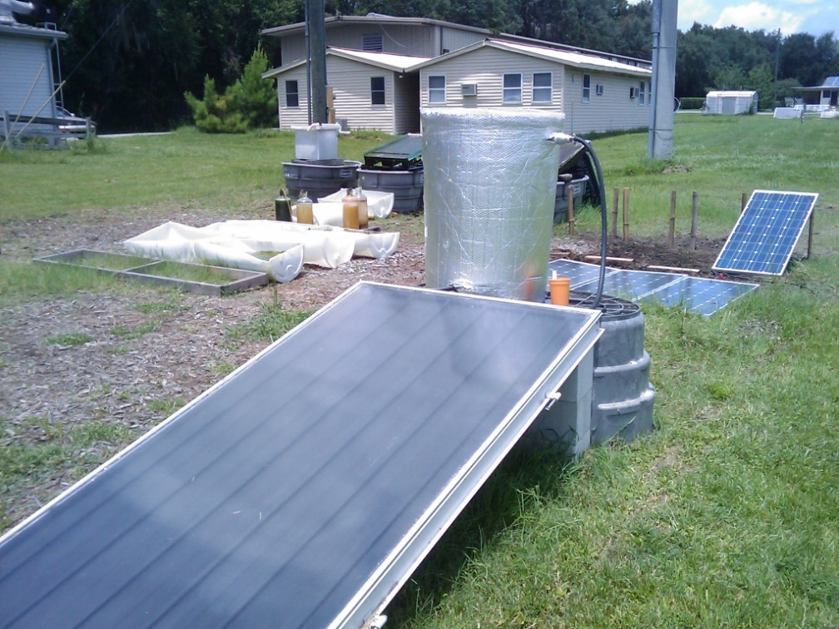
Flat Plate Collector Design Project
By Eric Layton

Slide 2
Design Project for 2009 Bioenergy Summer School
Engineer a solar flat collector that could be built in a developing nation
Must be portable and lighter than a typical solar collector
Possible applications:
  Hot water source
  Merged with anaerobic digestion
  Create a hot water tank for several people to utilize
  Sterilize water

Slide 3
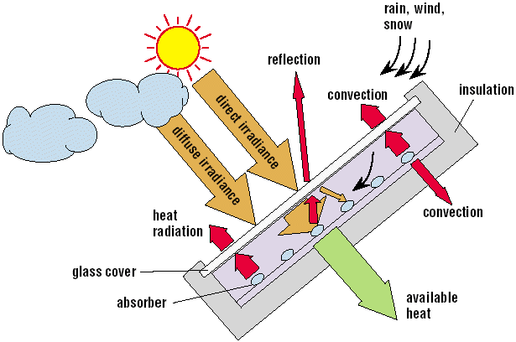
How does a flat plate collector work?
Creates heated air or water
Can be used on a cloudy or sunny day
http://www.volker-quaschning.de/articles/fundamentals4/figure1.gif

Slide 4
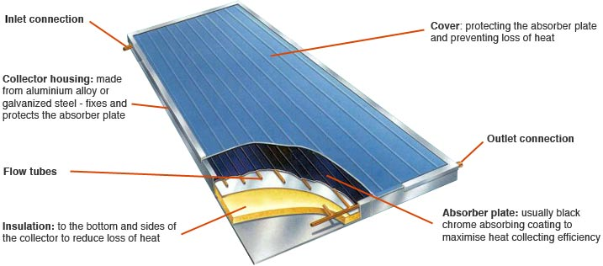
Design of a Solar Collector
http://www.greenspec.co.uk/images/energy/solarcoll/solarcol2.jpg

Slide 5
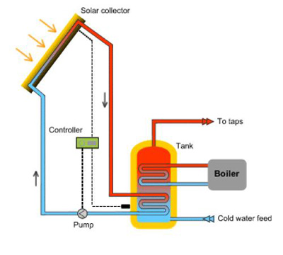
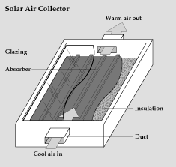
Typical Solar Collector System
Mainly used in residential applications across the world
  Widely used in Europe, North America, South America, and Australia
  Used for hot water applications
http://www.therenewableenergycentre.co.uk/images/category/solar_heating/SOLARdiagram.jpg
http://www1.eere.energy.gov/solar/images/illust_fig4.gif

Slide 6
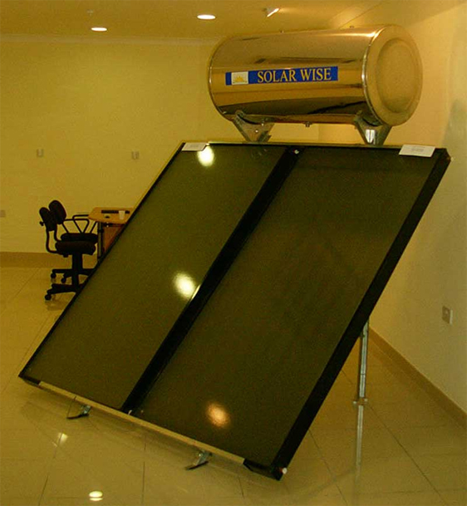
Solar Wise Solar Thermal Design
Used in Austrailia, China, India
Very expensive – upwards of $7,000 per system
Mainly businesses or commercial enterprises that purchase the Solar Wise system
Not a portable design

Slide 7


Application in Haiti
Haiti
  12% have access to safe drinking water in rural areas (World Health Organization)
  29% have access to safe drinking water in urban areas (World Health Organization)
  Solar thermal panel could be used for sterilization
http://www.tomorrowmuseum.com/wp-content/uploads/2008/05/haiti.jpg
http://mindset30.files.wordpress.com/2008/04/poverty_haiti.jpg

Slide 8
Principles to Consider
What materials can be used?
  Bamboo
  Plastic sheeting
  Metal/tin roof sheeting
  Wood
Mechanical Engineering Principles
  Water contact time with heating source
  Temperature for optimum hot water
  Material weight

Slide 9
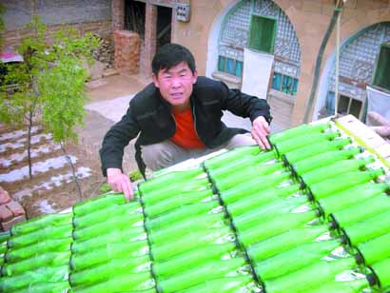
Unique Designs
Uses glass bottles from
landfill
Clay and silicone used to
fuse the bottles together
Plastic piping used on
top
and bottom for flow of
water
Mounted to plywood
board
http://www.ananova.com/news/story/sm_2360667.html
“Sunlight heats the water as is passes slowly through the bottles before flowing into the bathroom as hot water, reports China Economy Network. Ma says it provides enough hot water for all three members of his family to have a shower every day. And more than 10 families in the village have already followed suit and installed their own versions of Ma's invention.”

Slide 10
Specific Design Ideas
Two specific designs:
  Bamboo structure
    Metal roofing as the main metal source
    Plastic as the top panel for portability
    Hose or carved out bamboo for transport
    Lightweight design
  Plastic (PET) and glass bottle configuration
    Easy set up, possibly easier than bamboo design
    Lightweight design, limited by number of bottles
    Plastic bottles in plentiful supply in many developing countries

Slide 11
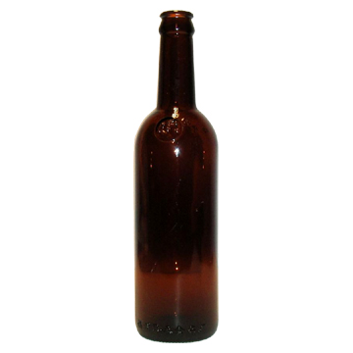
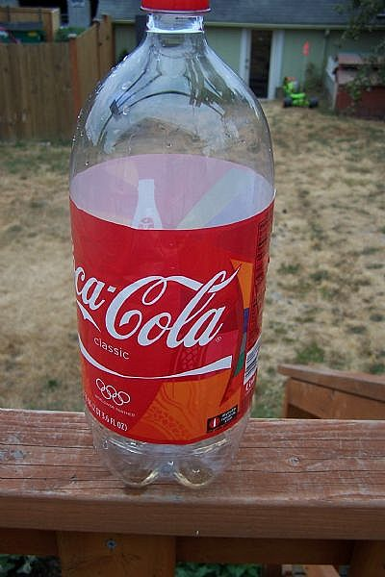
Current Design
Using glass bottles for heating water
Clay will be used to connect necks of bottles
Bamboo will be incorporated for transport of water and for main structure/wheels
If time persists a plastic bottle design will be built

Slide 12


Hot Water In
Hot Water
Tank
Valve
Cold Water Out
Notes:
Bamboo design with beer bottles

Slide 13
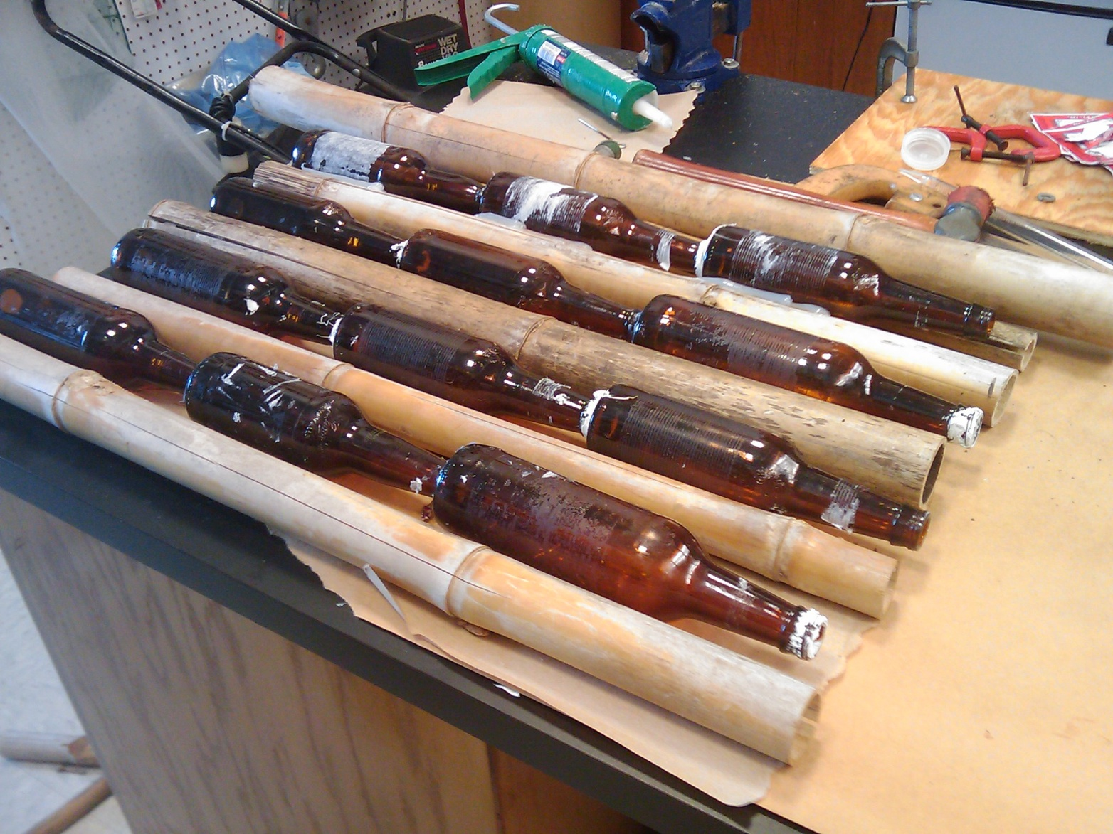
Progress in Design

Slide 14
Questions?

